Slide 1


HIRING PROCESS ANALYTICS

Slide 2


In this data analysis project, the objective is to analyze the hiring process data of a multinational company and draw meaningful insights from it. As a data analyst at this company, the task is to understand key trends and patterns in the hiring process to provide valuable recommendations for improving the hiring department's efficiency and decision-making.

Slide 3


The analysis will follow a systematic approach to ensure accuracy and reliability.
The first step involves data cleaning, handling missing values, and addressing outliers.
Next, descriptive statistics and visualizations will be generated to gain insights into the hiring process's various aspects, such as gender diversity, salary structure, departmental distribution, and position tiers.

Slide 4



MS EXCEL(Microsoft 365 version)

Slide 5
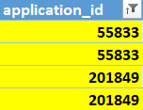


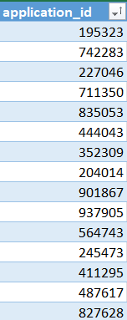



There are 54 duplicate application IDs.
There is one post in the Post name that is not defined(application ID – 289907).
There are 15 people who haven’t defined(Don’t want to say not included) their gender.
There are 3 people who are earning more than 2 lakhs, but the average is nearly 50k.

Slide 6







Hiring Analysis
Salary Analysis
Salary Distribution
Departmental Analysis
Position Tier Analysis

Slide 7
Hiring Analysis
HIRED
There were 7168 applications, out of which 4697 were hired and the remaining ones were rejected. Among the 4697 who got hired, 1856 were female candidates while 2563 were male candidates.
rejected

Slide 8

Salary Analysis
AVERAGE:
Rs 49983.03
According to the dataset provided the average salary offered by the company is
Rs 49983.03.

Slide 9
Salary Distribution
I have distributed the candidate who has been hired by the company based on class interval. After distribution, I found that only 3 candidates have been offered more than 1 lac.

Slide 10
Departmental Analysis
Out of the 9 departments, only 2 have the highest number of employees working in them and the rest of the 7 departments have less than 11% of the total candidates hired by the company.

Slide 11
Position Tier Analysis
I've created some graphs that showcase the average salary offered to each tier in the different departments. As you know, each department has its own priorities, and the salary is based on that. In total, there are nine departments, and I’ve created 9 bar charts to represent the position of each tier in a department.

Slide 12

Position Tier Analysis
OUTLIER
FINANCE DEPARTMENT
GENERAL MANAGEMENT
HUMAN RESOURCE DEPARTMENT
OPERATIONS DEPARTMENT
MARKETING DEPARTMENT

Slide 13
Position Tier Analysis
PRODUCTION DEPARTMENT
PURCHASE DEPARTMENT
OUTLIER
SALES DEPARTMENT
SERVICE DEPARTMENT
EXCEL LINK: click here

